Slide 1

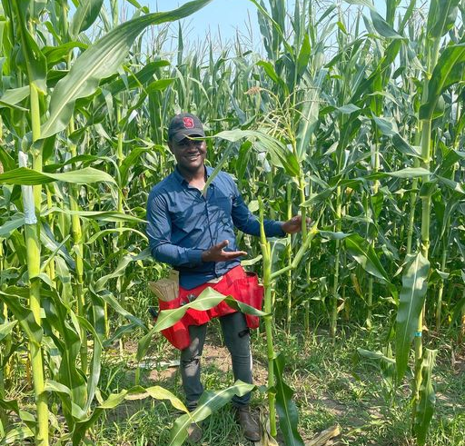
Discovering STEM in ACES Program (DSAP) 2023
Mentor: Chris Mujjabi

Slide 2
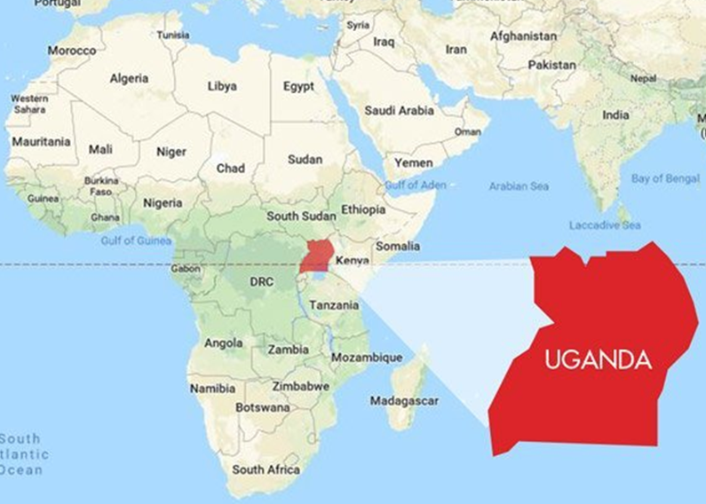

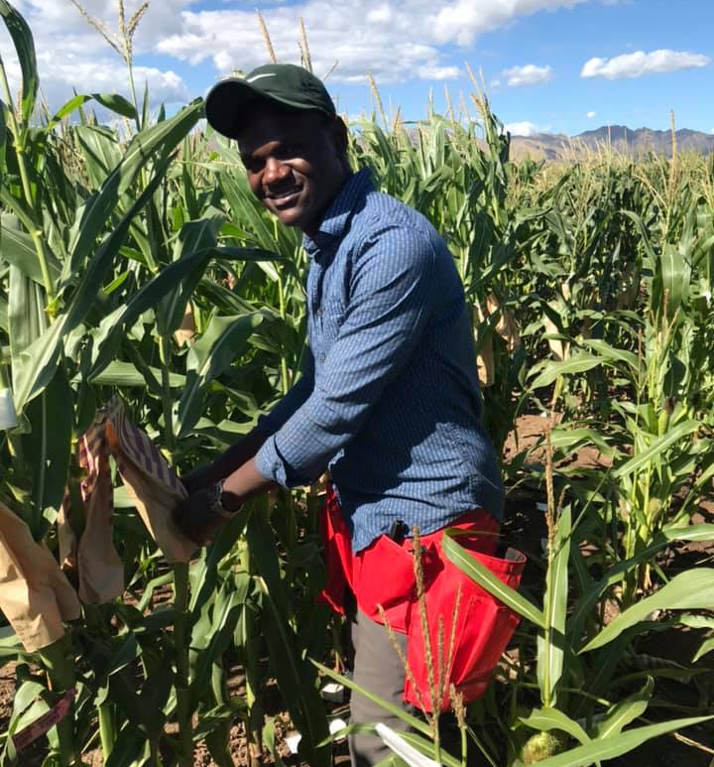


From in Uganda
Undergraduate in Costa Rica
Bachelor degree in Agronomy
UIUC since 2018
Masters Degree
PhD Student – Bohn Lab

Slide 3
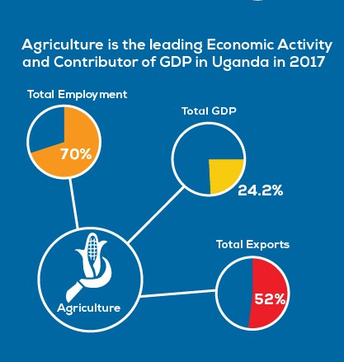
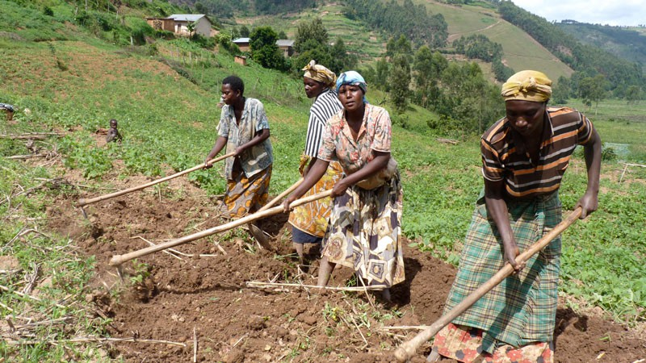
Importance of DSAP
Exploring the different carriers in Agriculture
Mostly subsistence farming
Highest percentage of farmers are women
“Peasant farmers”

Slide 4
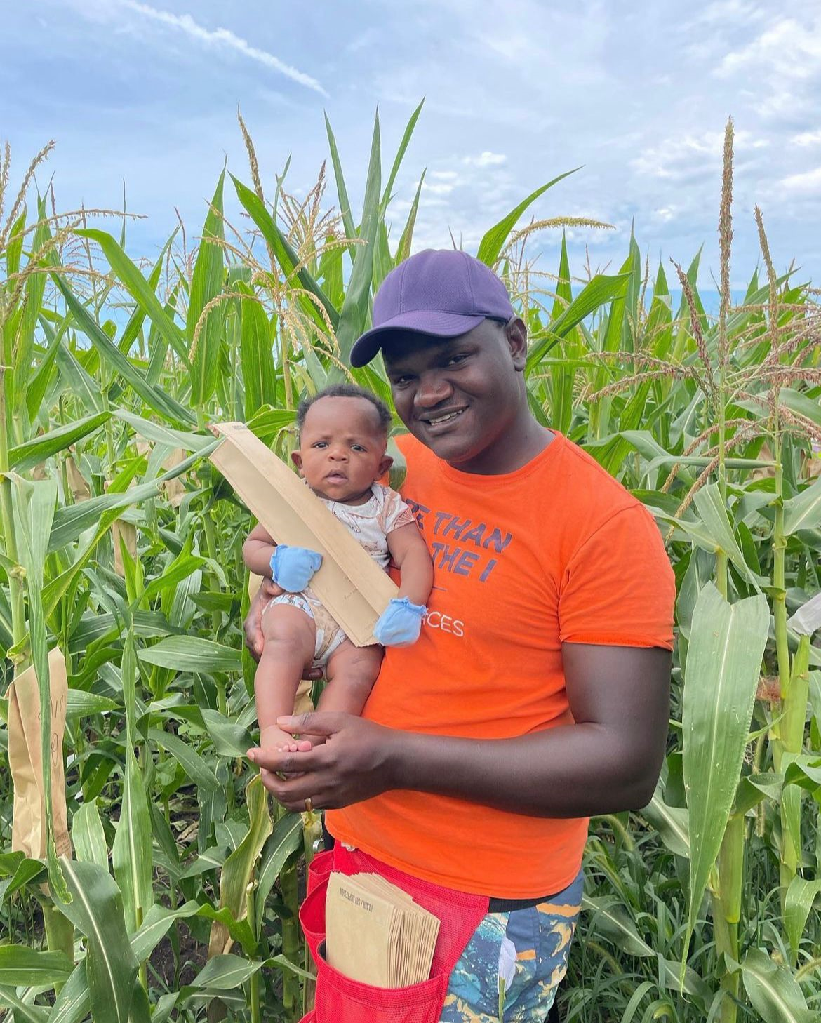
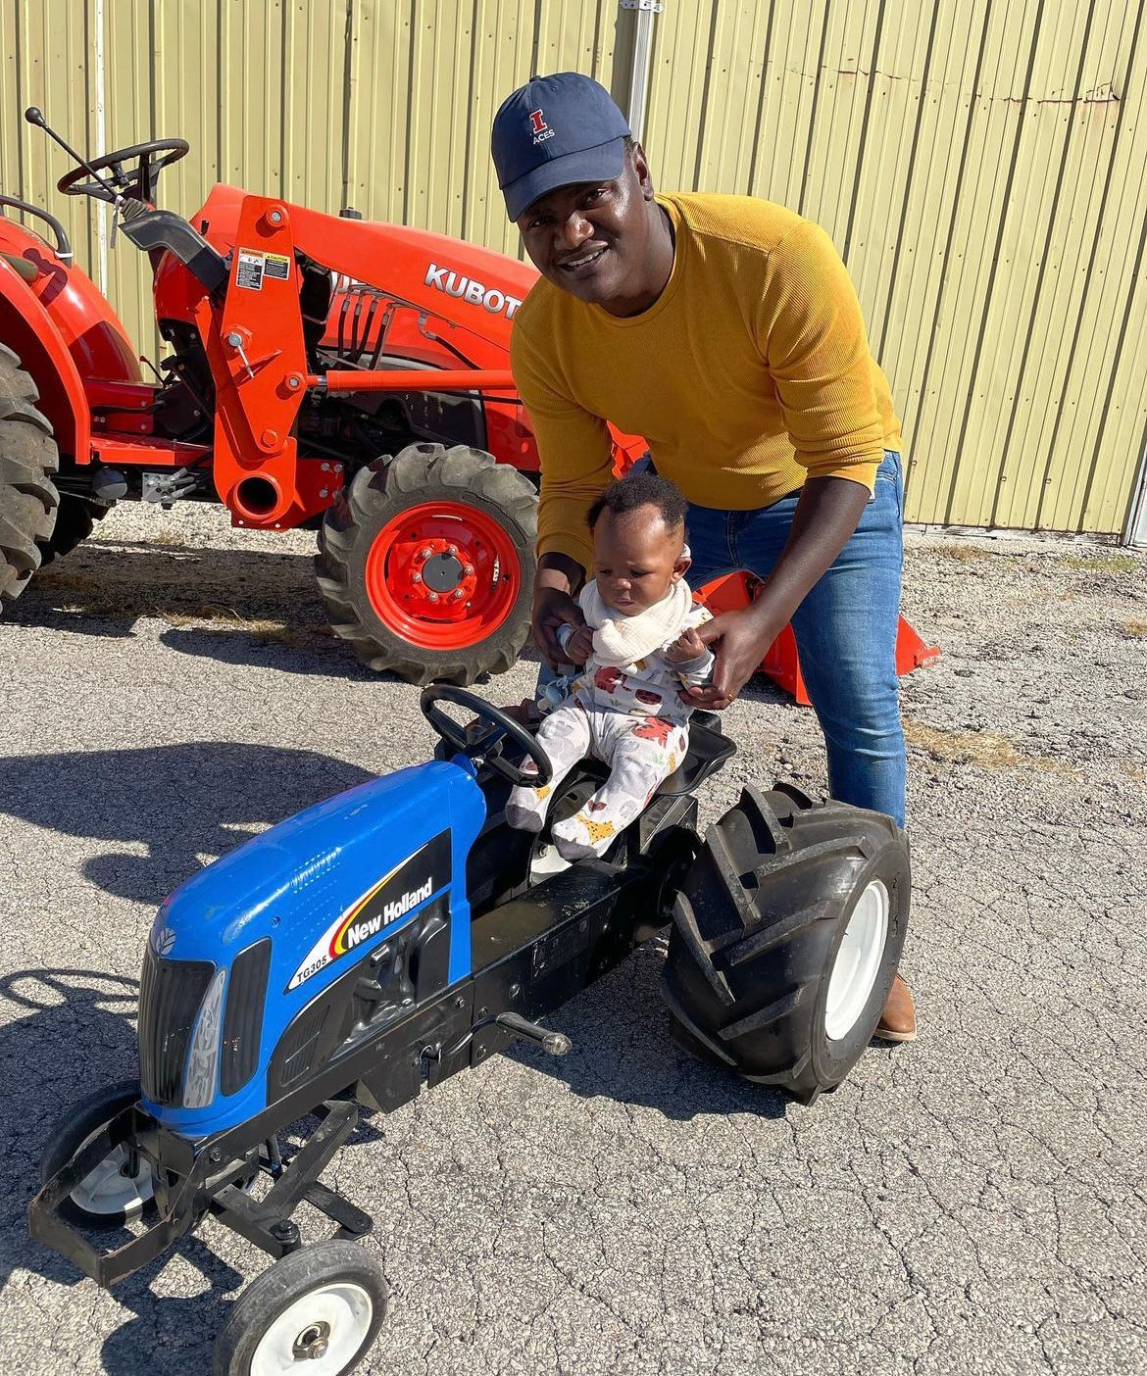
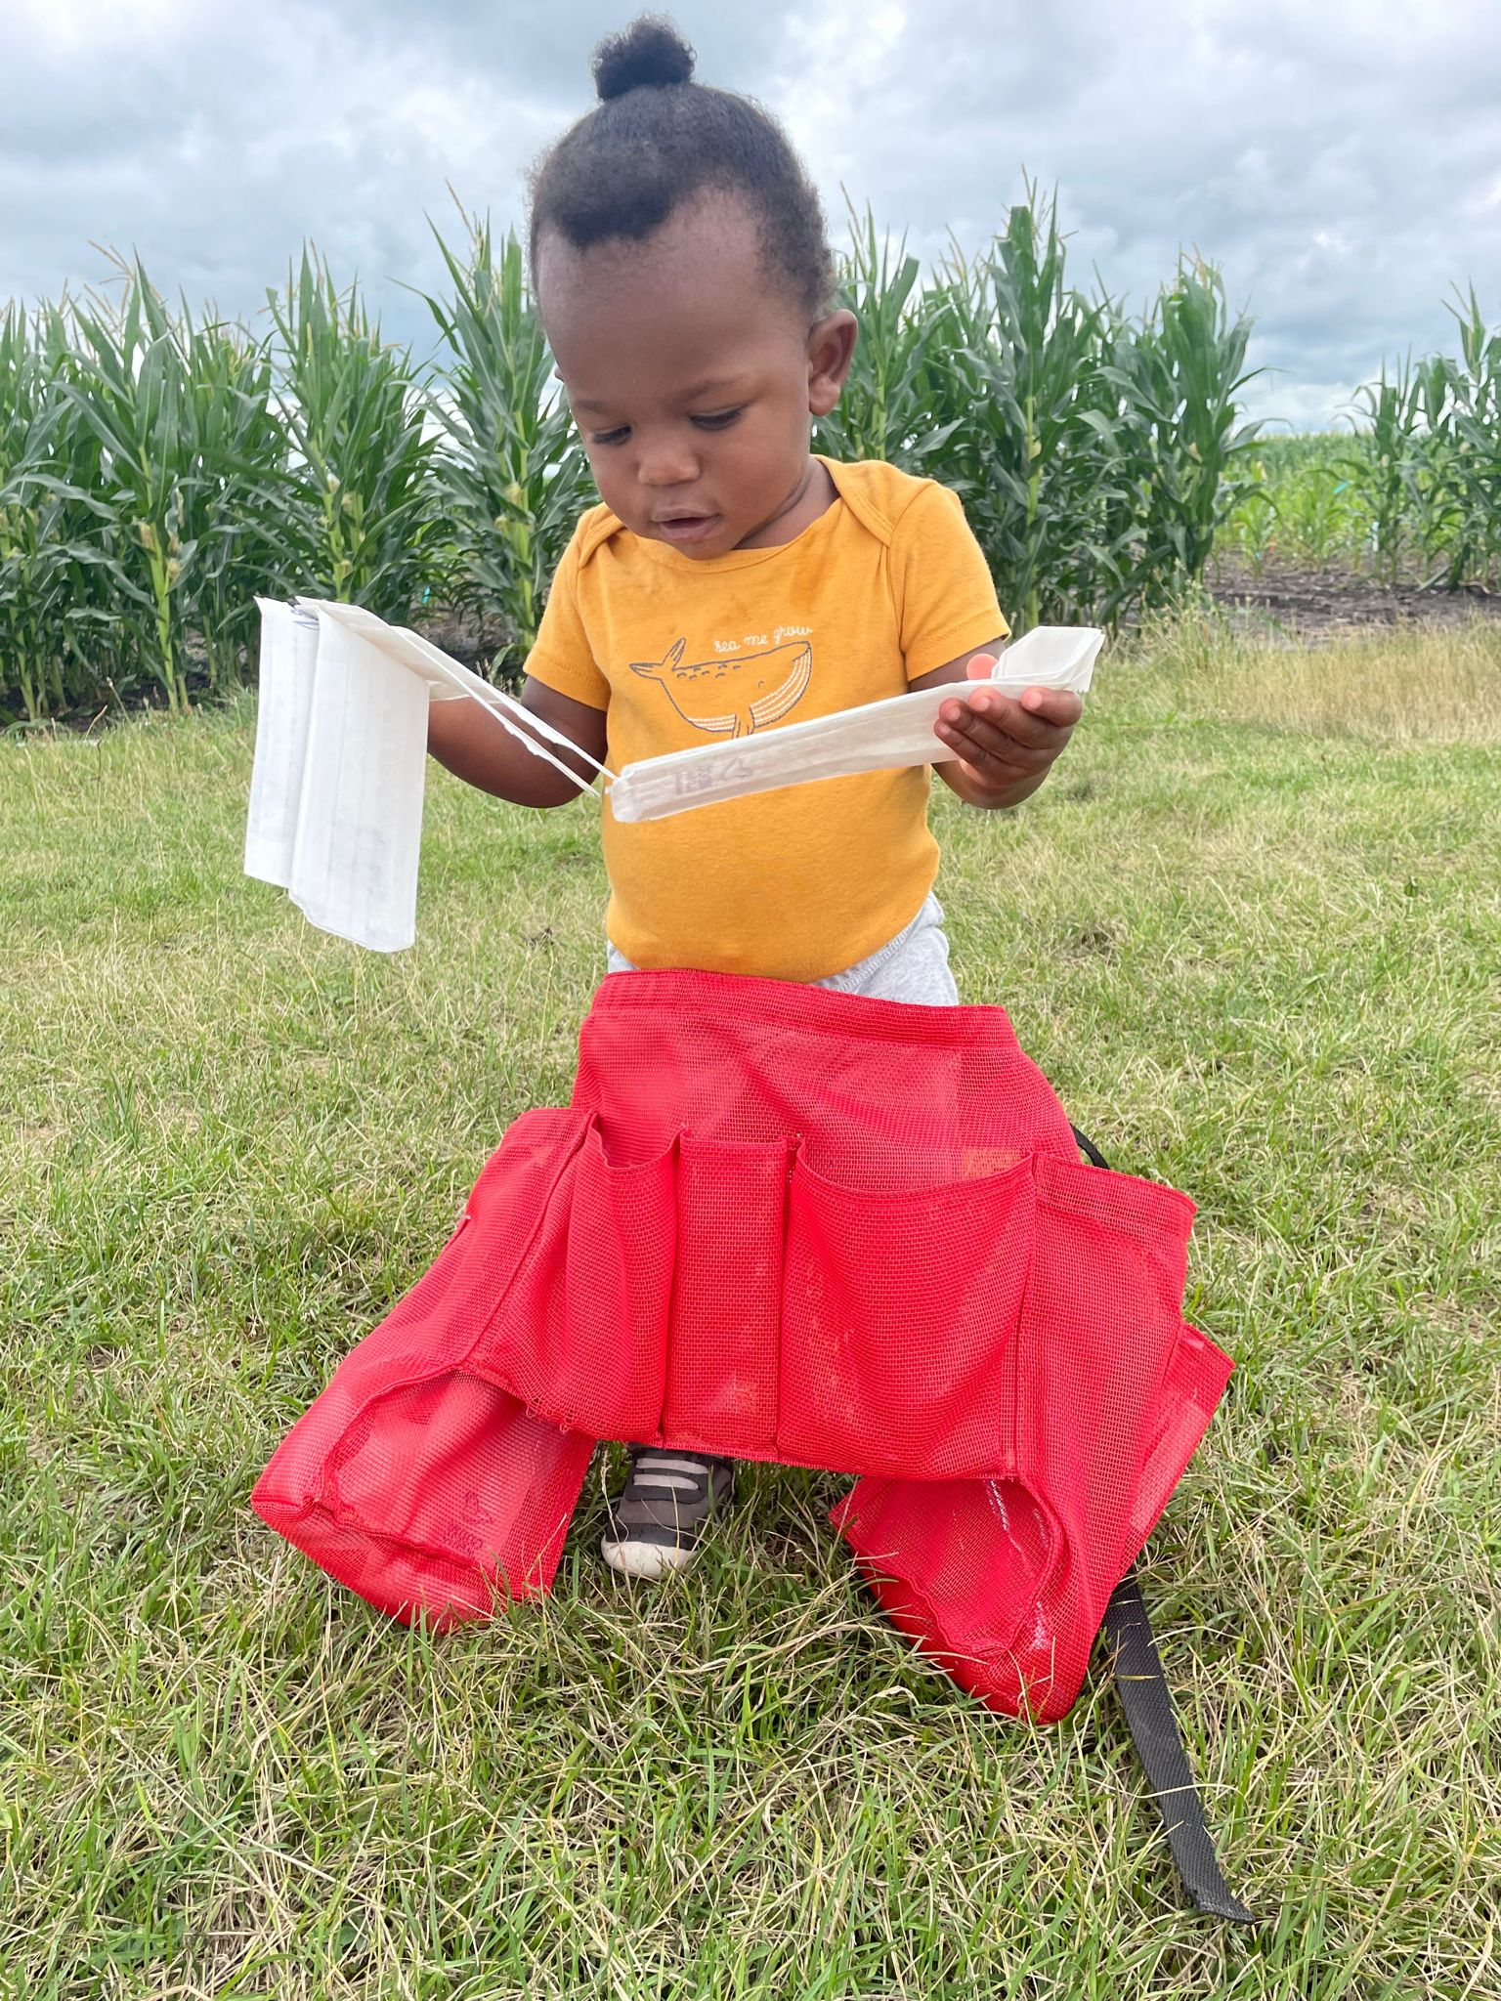
The Corn baby

Slide 5
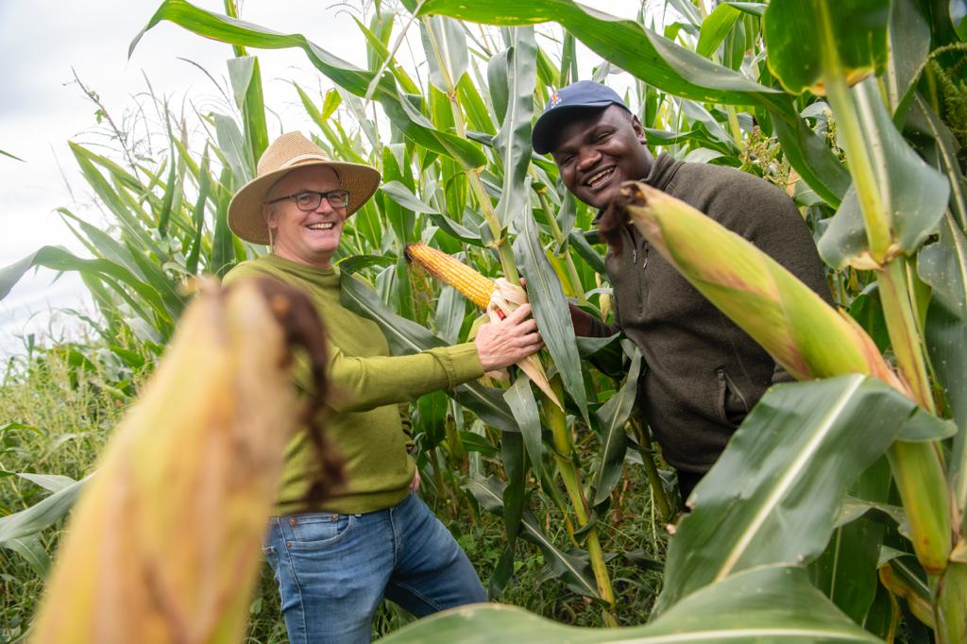
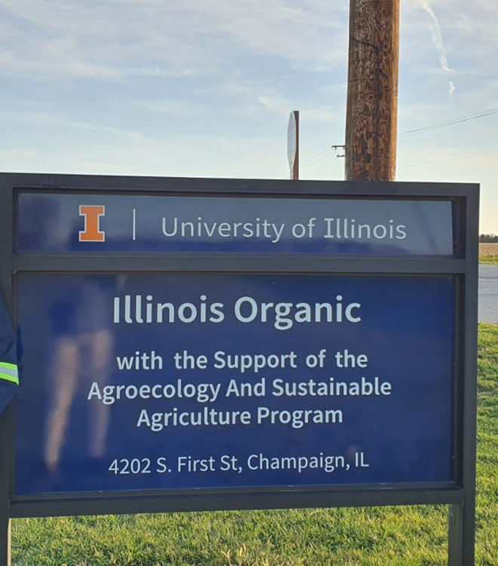
The Bohn Lab
Breeding corn cultivars for organic farming systems
High-Throughput phenotyping technology in maize for Breeding
Grain Nutritional Quality in maize
Root development and architecture
Maize performance under biotic and abiotic stresses.

Slide 6
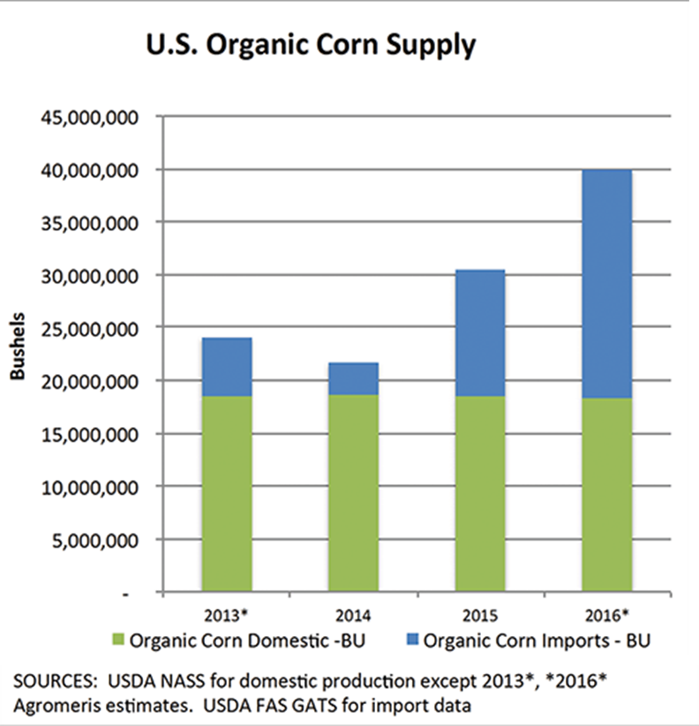
Breeding maize for organic systems.
Demand for organic products has surpassed domestic supply
Increased importation of organic products including corn
Farmers use conventionally bred varieties
Poor performing under organic systems
(Midwest Organic & Sustainable Education Service, 2017)

Slide 7
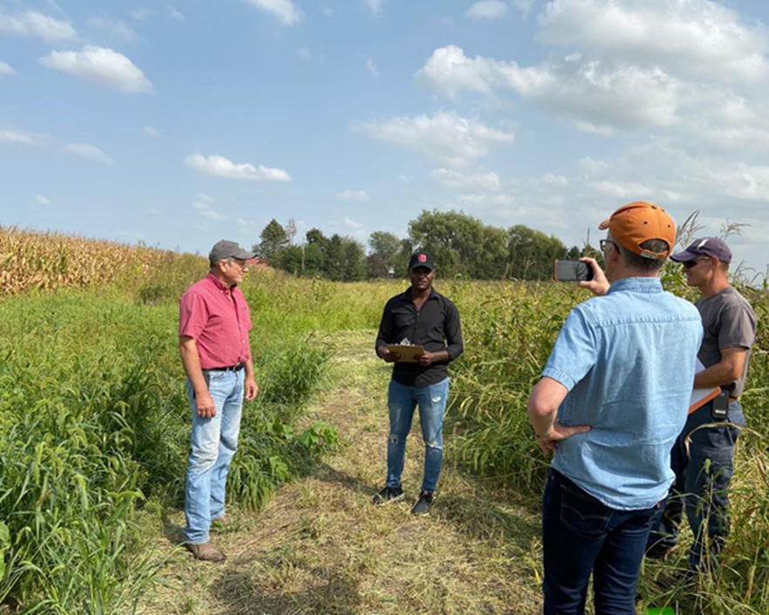
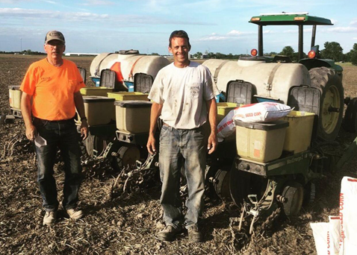
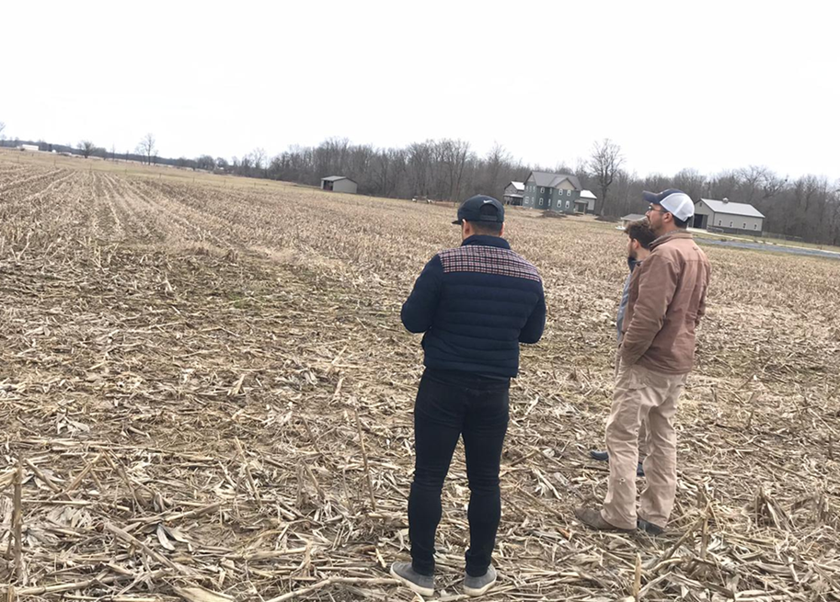
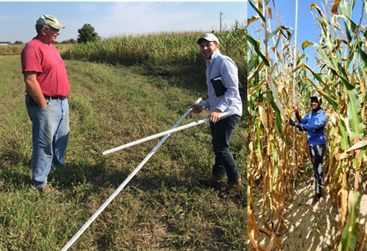
Participatory Breeding with a Variety Testing Network of Organic growers (2018 – 2021)
Organic farmers in IL, IN & WI
Evaluated performance of our germplasm under organic conditions
Identified traits of interest for organic farmers (weed pressure tolerance, grain quality, nutrient use-efficiency etc)
Baseline for current project focused on speed breeding for organic systems.
Winter nurseries (Puerto Rico)
Doubled haploids
Genomic prediction

Slide 8
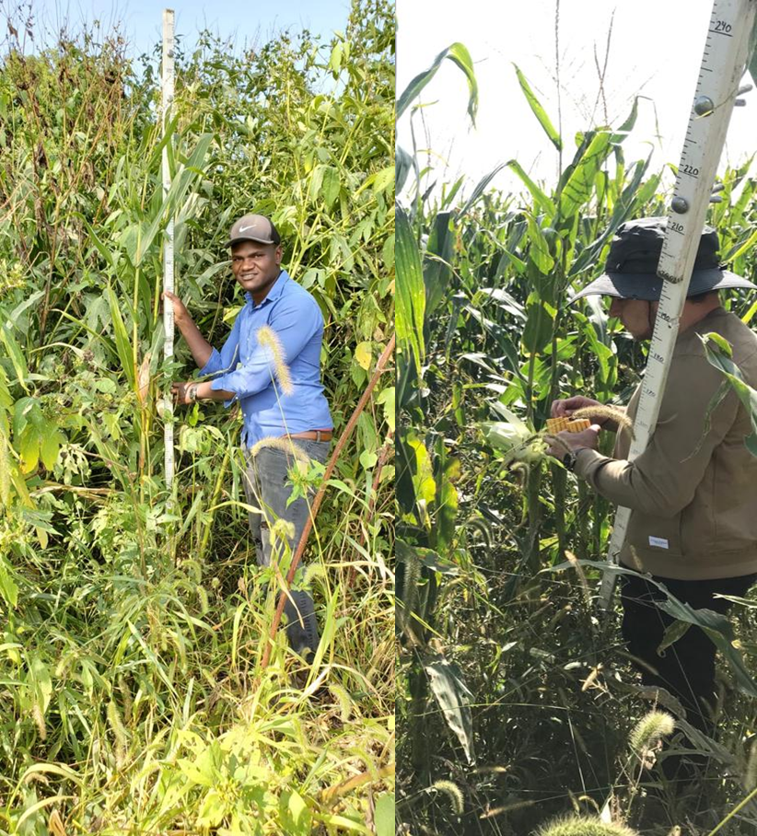
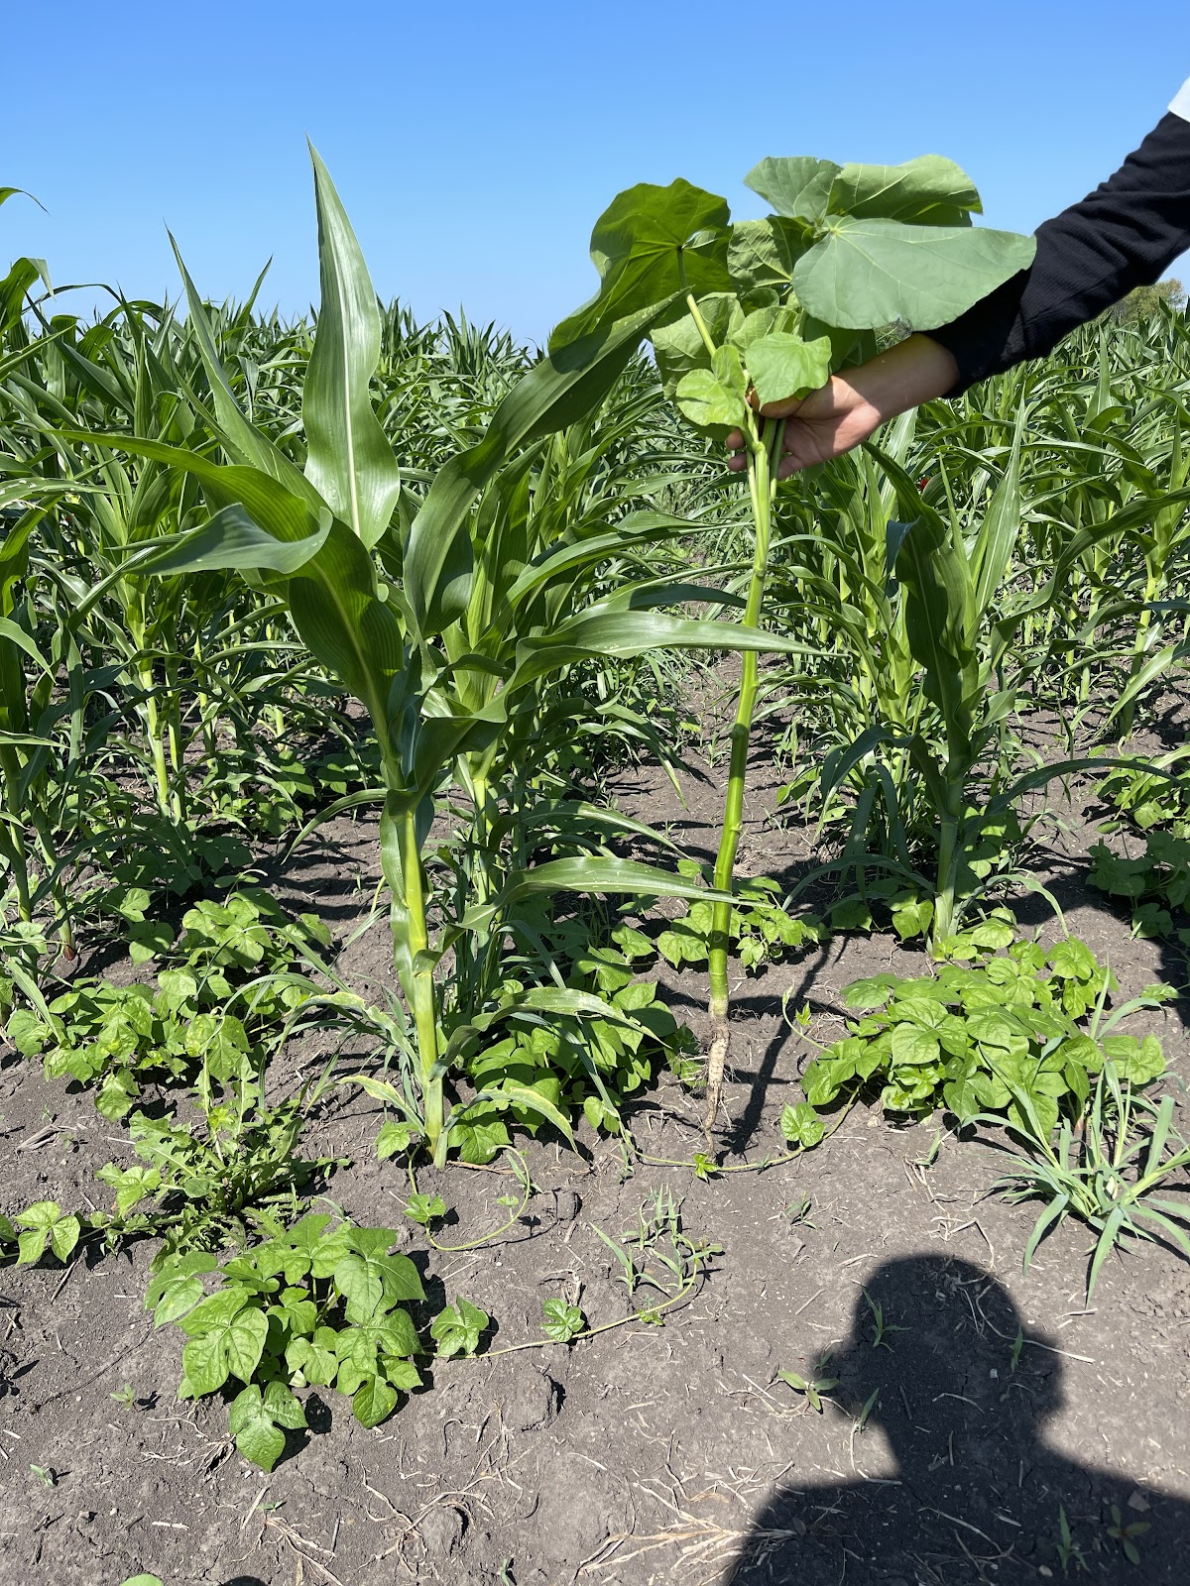
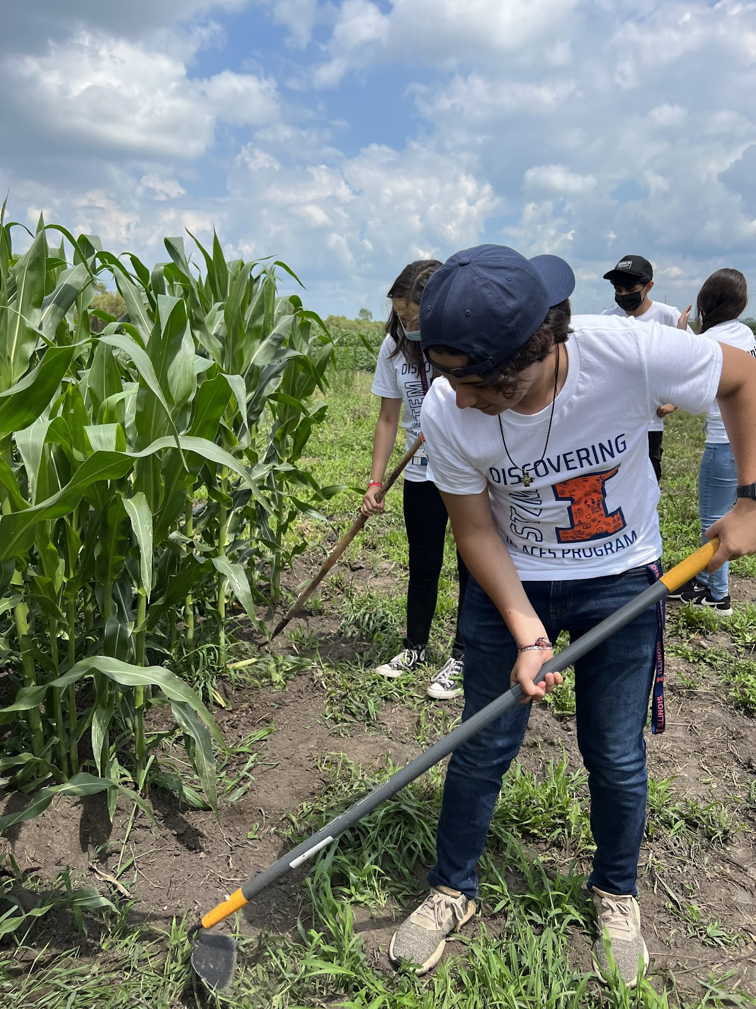
Organic Vs Conventional Production Systems
Weed management
Soil nutrient sources
Seed / plant cultivar availability
Breeding aspects

Slide 9
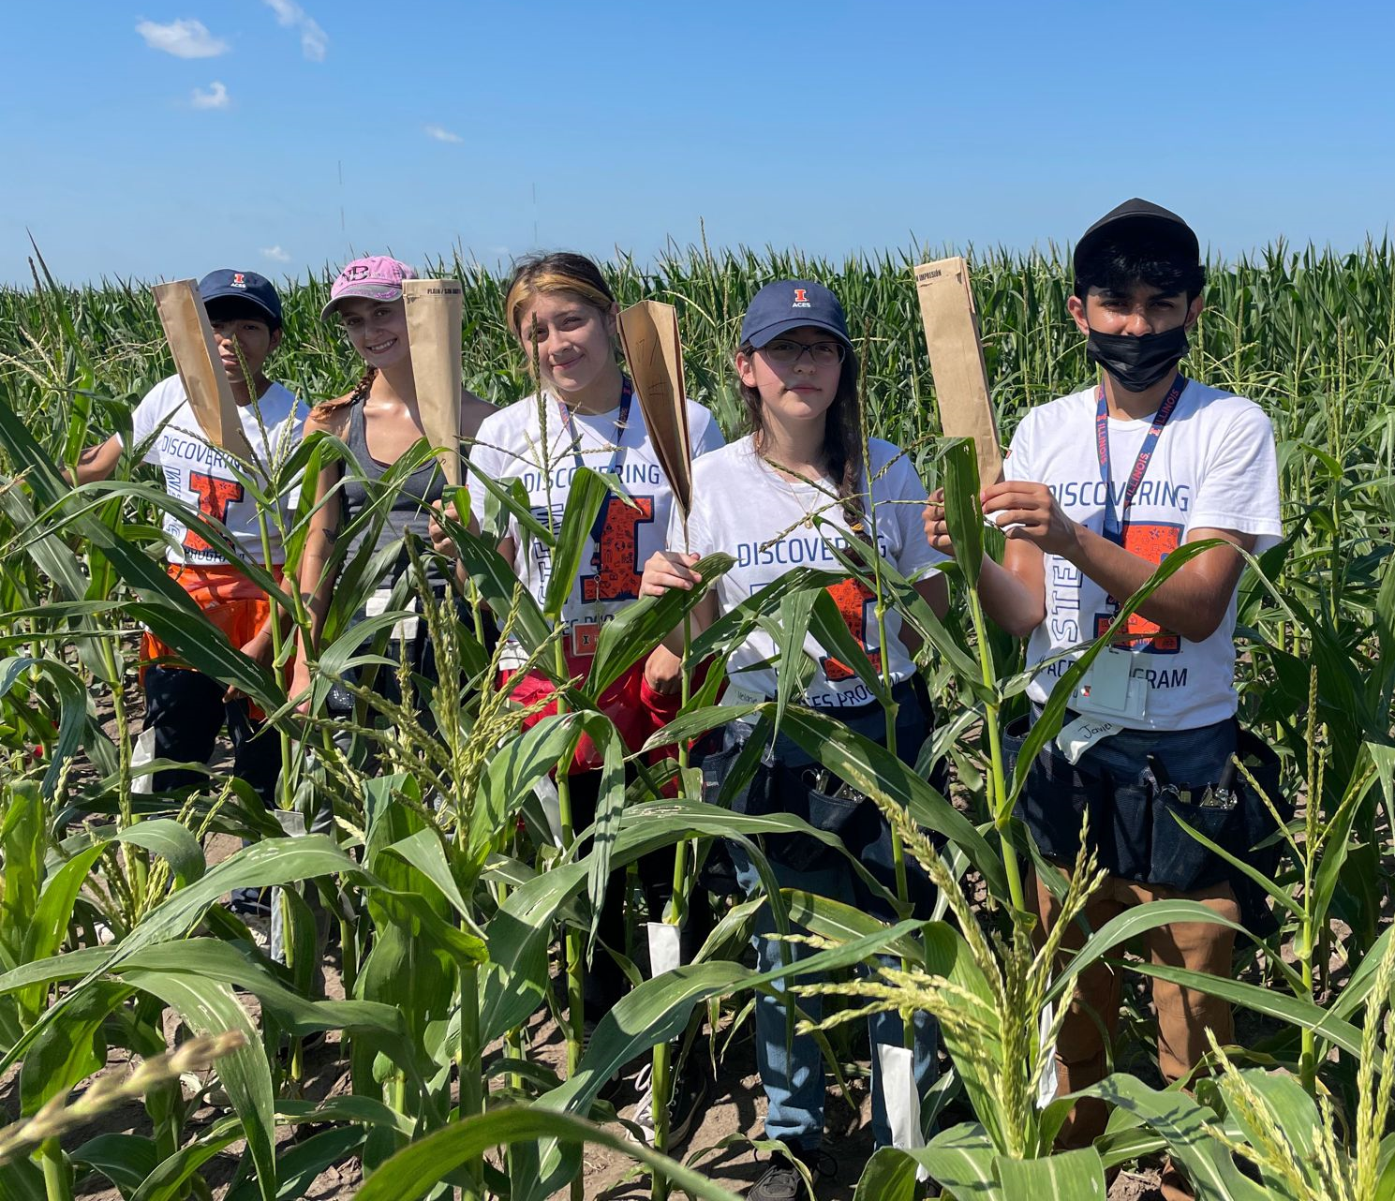
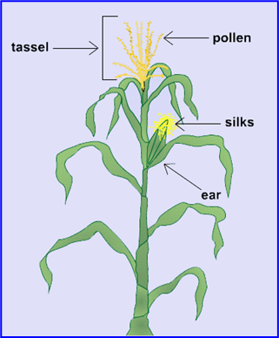
Maize Pollinations (Seed Production)
Learn the morphology of a maize plant
Cross pollination
Self Pollination
Difference between inbreds and hybrids

Slide 10
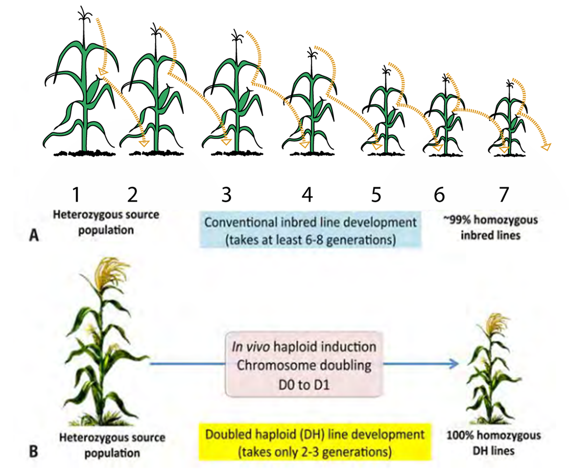
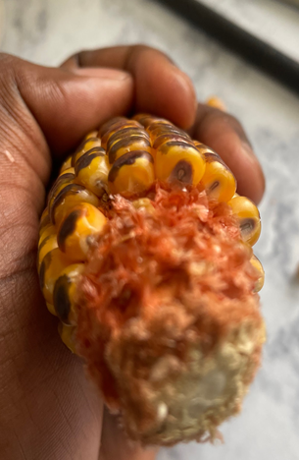
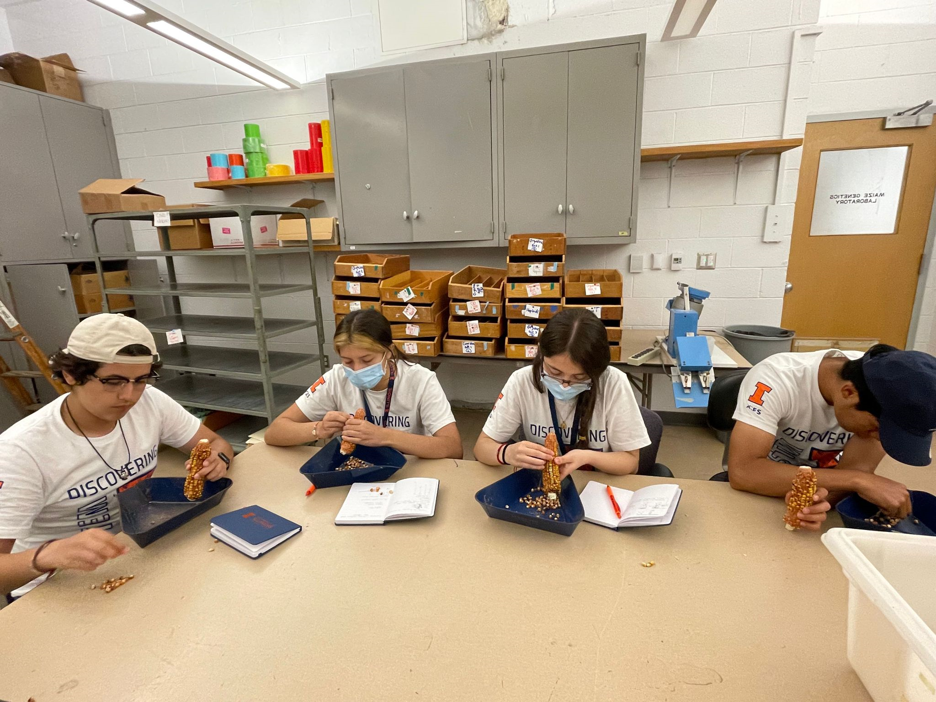
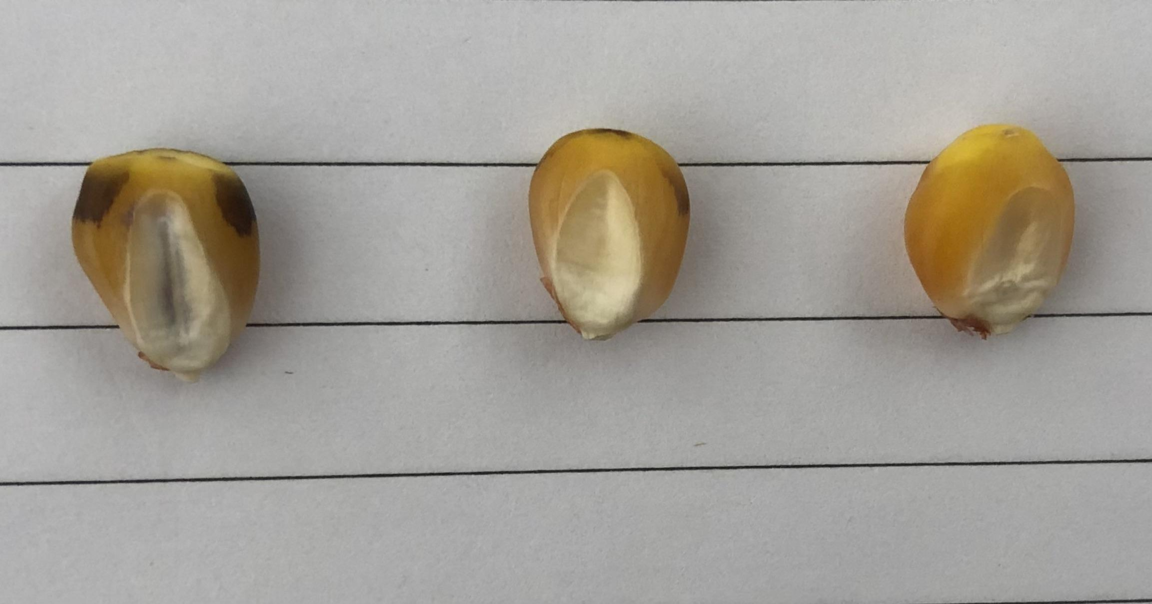
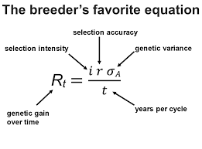
Introduction to Doubled haploid technique in corn breeding (Speed Breeding)
Breeder’s Equation
Diploid
Haploid
Contamination

Slide 11
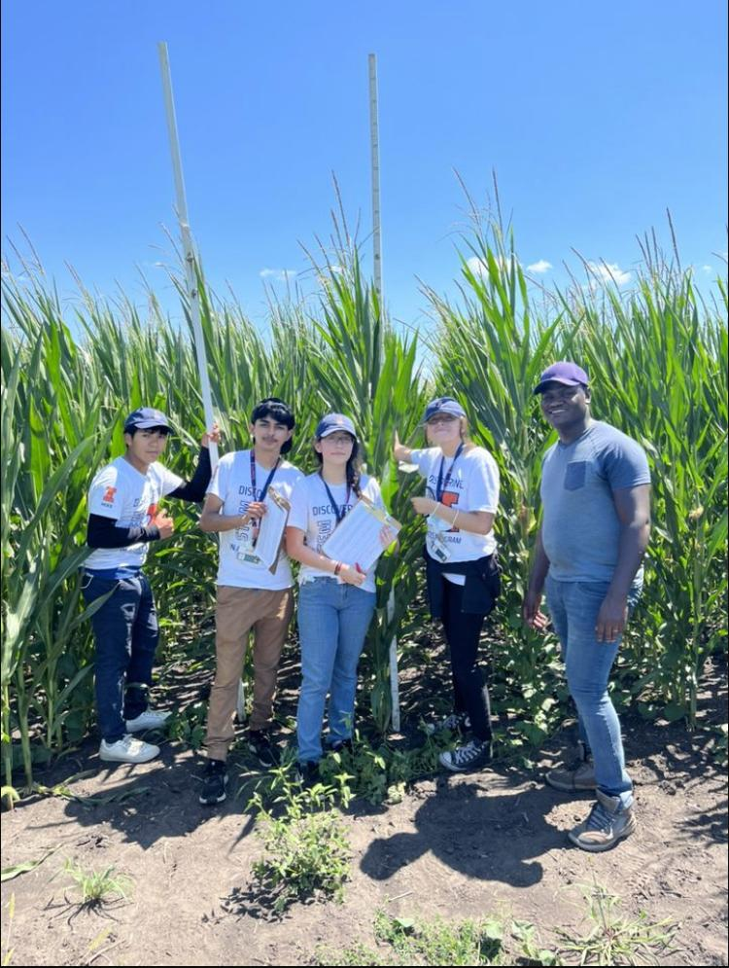
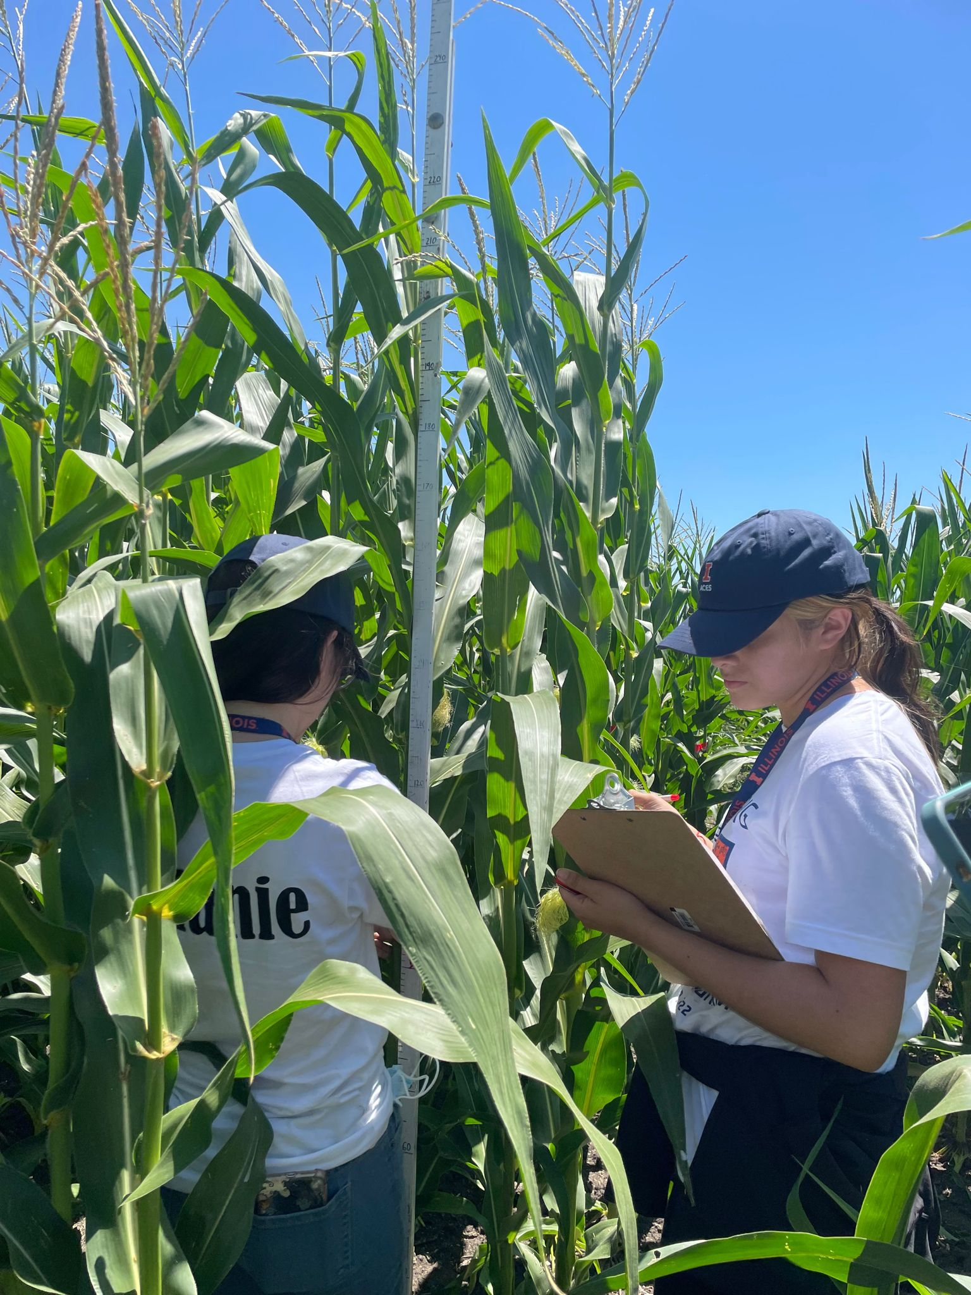
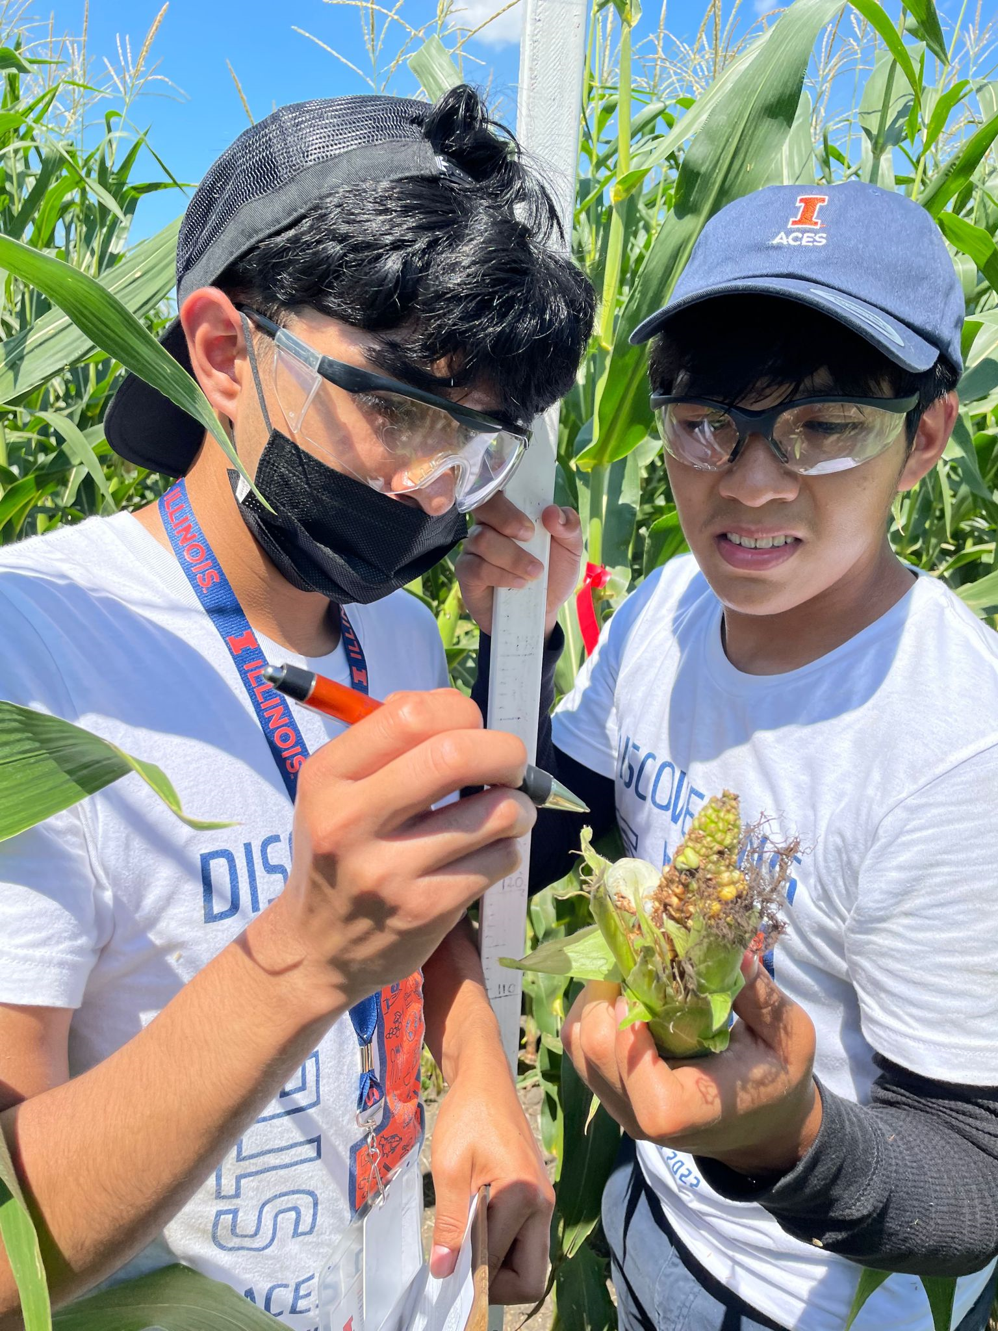
Phenotyping and Trait Evaluation (Data Collection)
Measuring plant height (PHT) and ear height (EHT)
Diseases
Indicators of yield

Slide 12
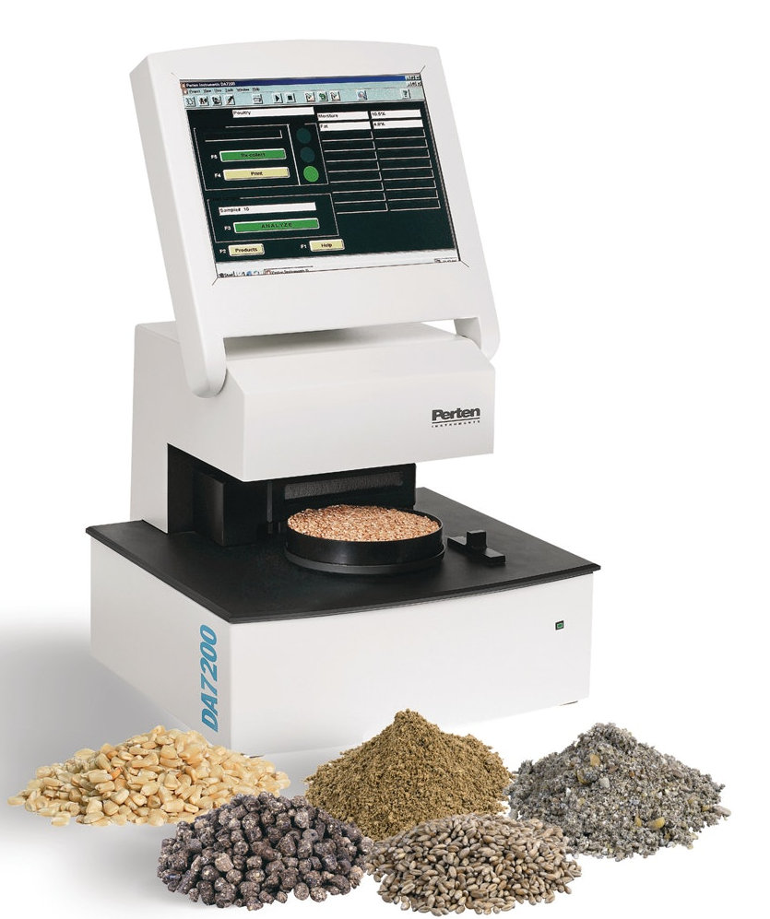
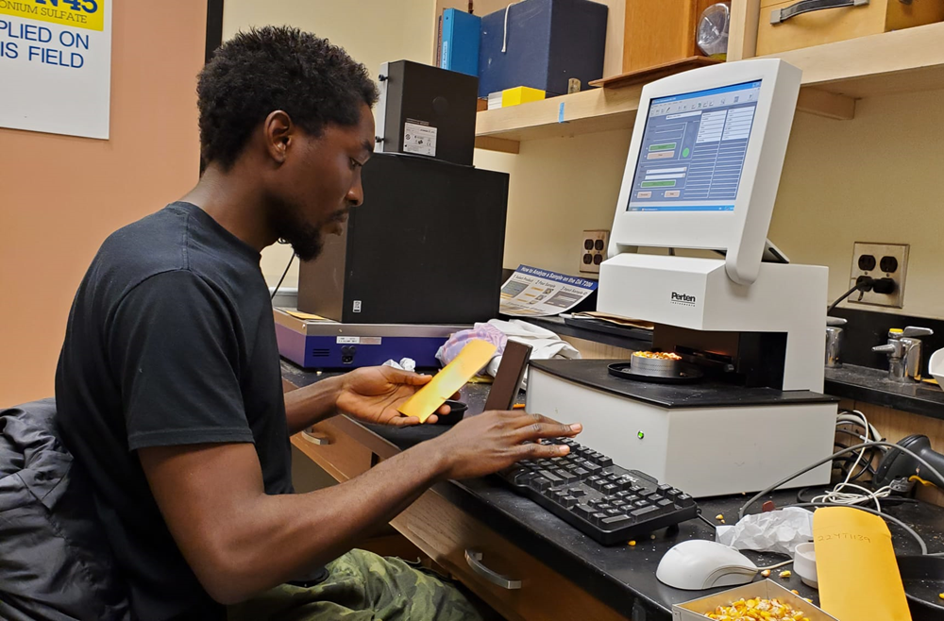
Phenotyping and Trait Evaluation (Data Collection)
Use NIR machine to determine kernel chemical composition
Measure compositional traits like percentage starch, protein and oil
Indicators of nutritional value

Slide 13

Introduction to Statistical Analysis and Hypothesis Testing
Use R Software to conduct a statistical analysis of the phenotypic data collected in the previous session
Test if N treatment influences hybrid performance. (Hypothesis testing)
Generate visual representation of our data (graphs, charts and figures in R)

Slide 14

Undergraduate student panel

Slide 15
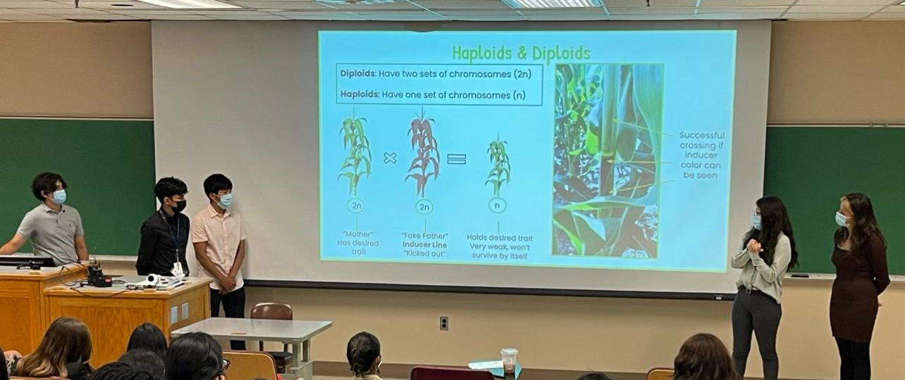
Presentation
Reporting research findings
Answer any pending questions

Slide 16
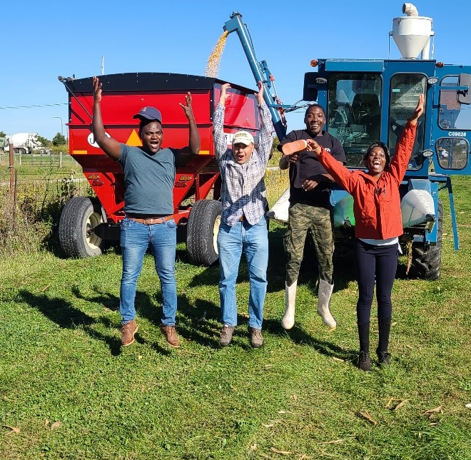
Thank you!!
and
Choose Crop Sciences

